Slide 1
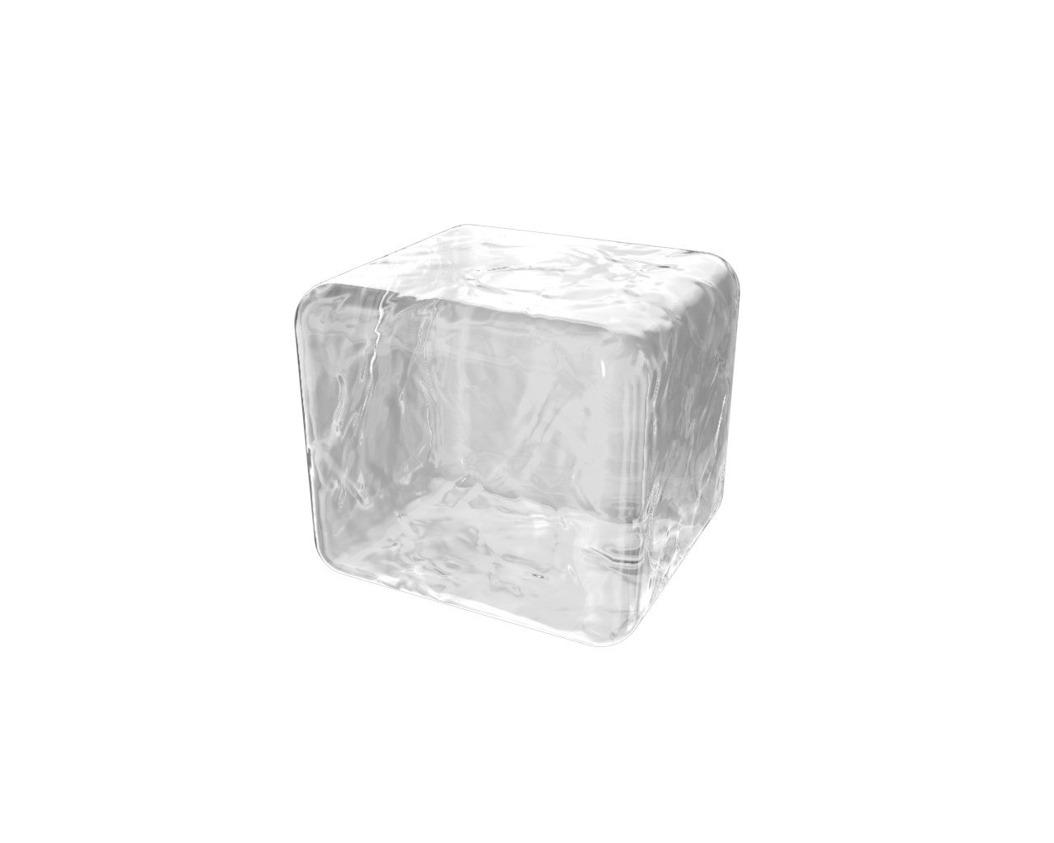


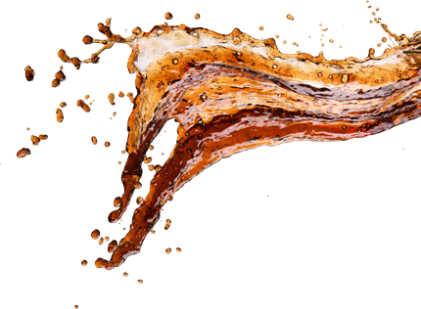
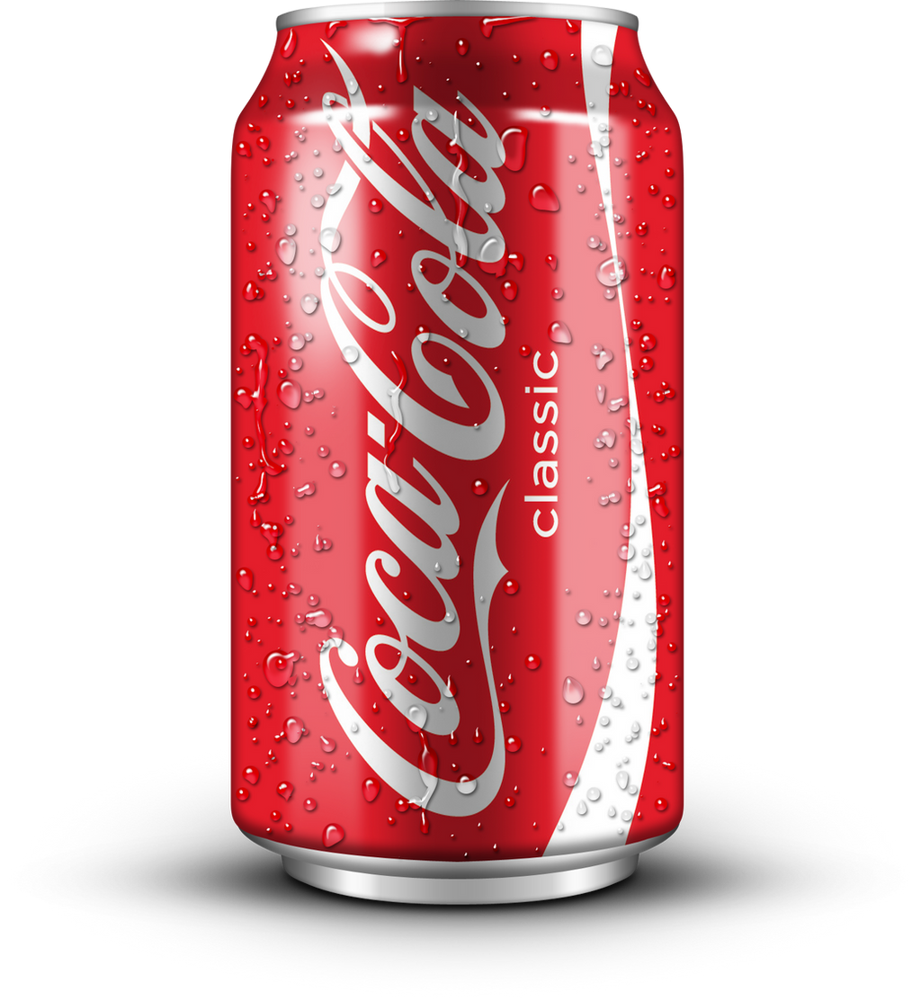

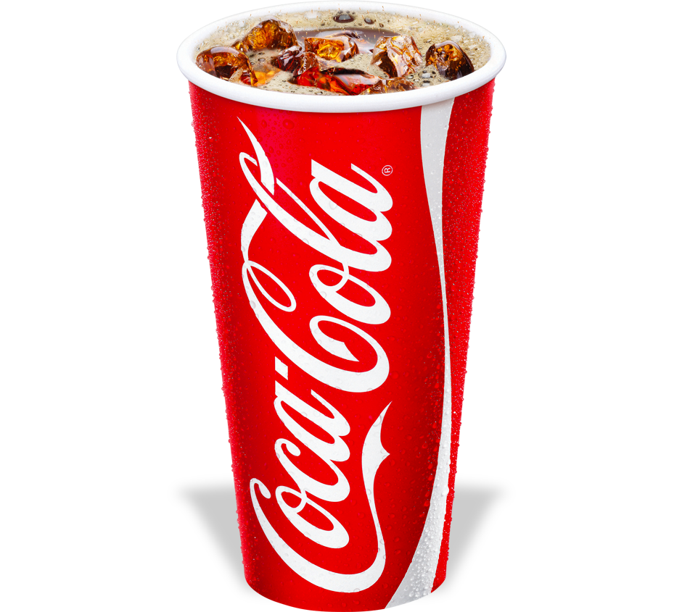
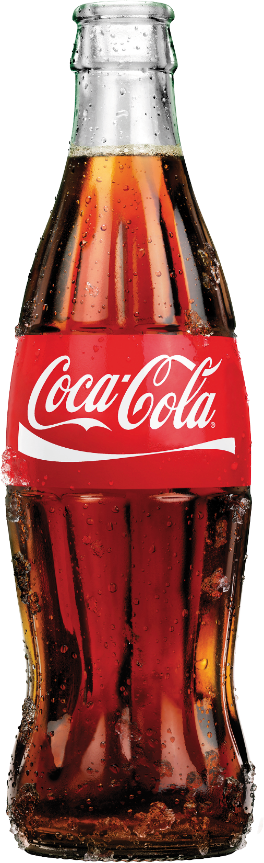

PowerPoint Presentation

Slide 2




Select a heading below to open it and see a list of links to PowerPoint Help
Coca cola
Select a heading below to open it and see a list of links to PowerPoint Help
PowerPoint Presentation
Select a heading below to open it and see a list of links to PowerPoint Help

Slide 3
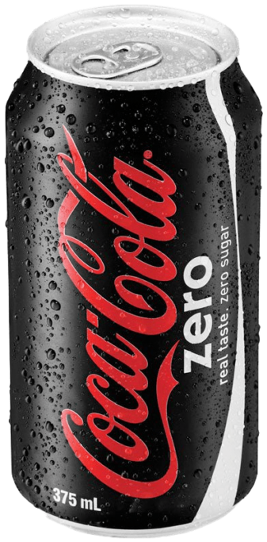
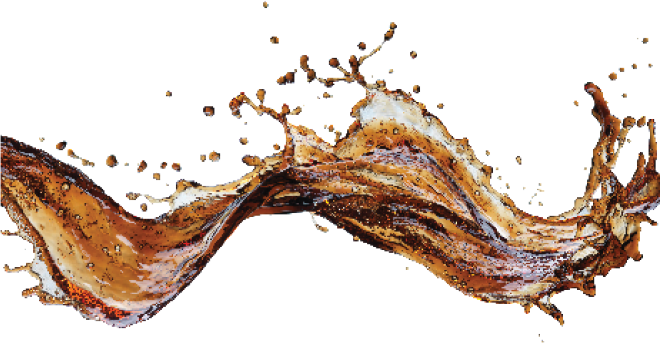
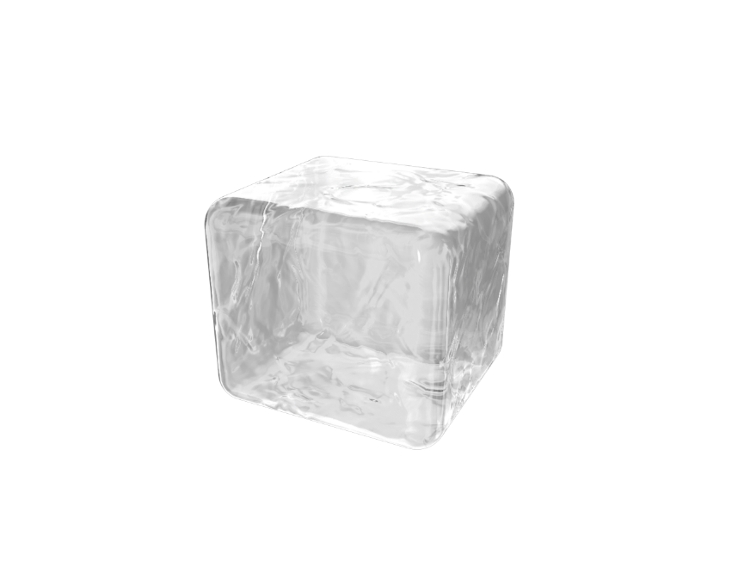
Select a heading below to open it and see a list of links to PowerPoint Help
Zero
ZERO
Select a heading below to open it and see a list of links to PowerPoint Help
Select a heading below to open it and see a list of links to PowerPoint Help
104.5mg/l
106 G/L
Caffeine
Caffeine
420mg/l
Caloric

Slide 4
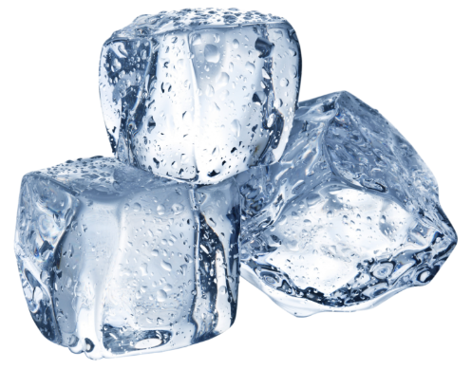
Coca cola
Zero
ZERO
104.5mg/l
106 G/L
Caffeine
Caffeine
420mg/l
Caloric

Slide 5
Thanks for watching

